Slide 1
Audio programming using C++ and Pure Data
Jonathan adam, Marcus Groth, Nicolas Pignier
DT2410 AUDIO TECHNOLOGY, 14 December 2016

Slide 2
Agenda
Introduction
Record and playback of audio using C++
Demo
Programming a mixer in Pure Data with live remote control via OSC
Demo
Conclusion

Slide 3
Introduction
Low-level and high-level audio programming
Different challenges
Different applications
Different users
Challenges
Not much experience with system programming
Little to no previous knowledge of Pure Data

Slide 4
Record and playback of audio using C++

Slide 5
Demo

Slide 6
Programming a mixer in Pure Data with live remote control via OSC
Pure Data: high-level visual audio programming
Patch, canvas, object, message, number, symbol, comment
Objective: design a mixer with
four instrumental tracks,
a live vocal track,
Various effects,
Remote control of an effect on the live track.

Slide 7
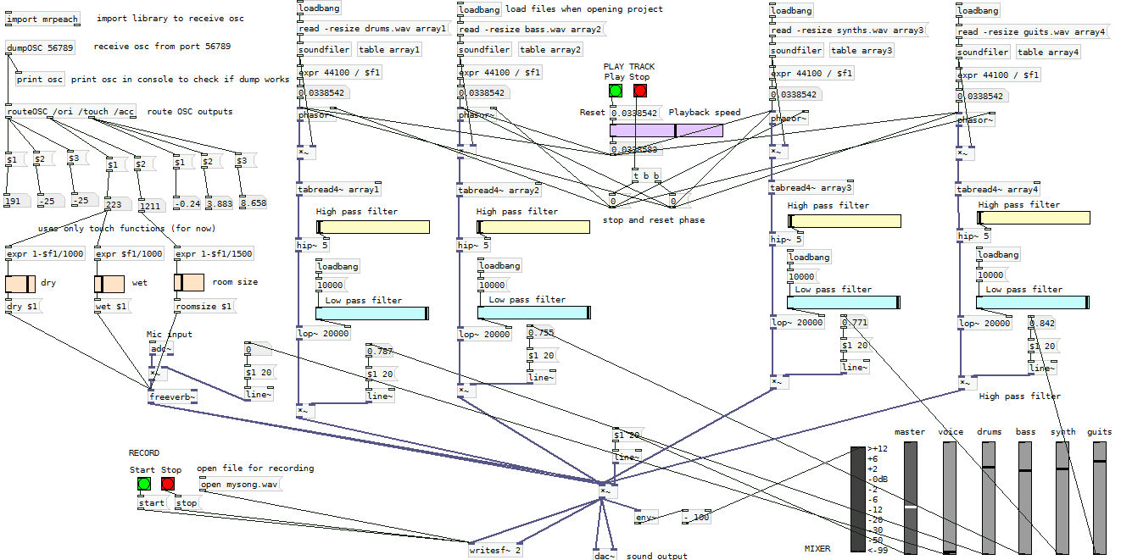
Overview of the patch

Slide 8
Overview of the patch

Slide 9
Overview of the patch

Slide 10
Overview of the patch

Slide 11
Overview of the patch

Slide 12
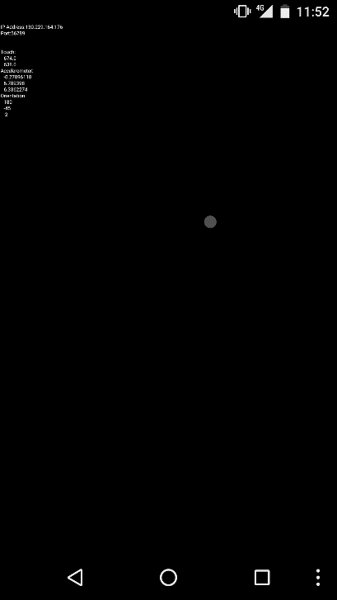
Remote control via OSC
andOSC

Slide 13
Demo

Slide 14
Conclusion
Challenges in real-time audio programming
Uninterrupted play
Need to master the way memory is handled
Challenges in visual programming
Powerful, quickly gives interesting results
Visualization limited by size of canvas
Works fine as long as it works, difficult to analyze in depth if problem
Can become messy with the connectors

